Slide 1

SharePoint Starter Kit
Anders Dissing

Slide 2
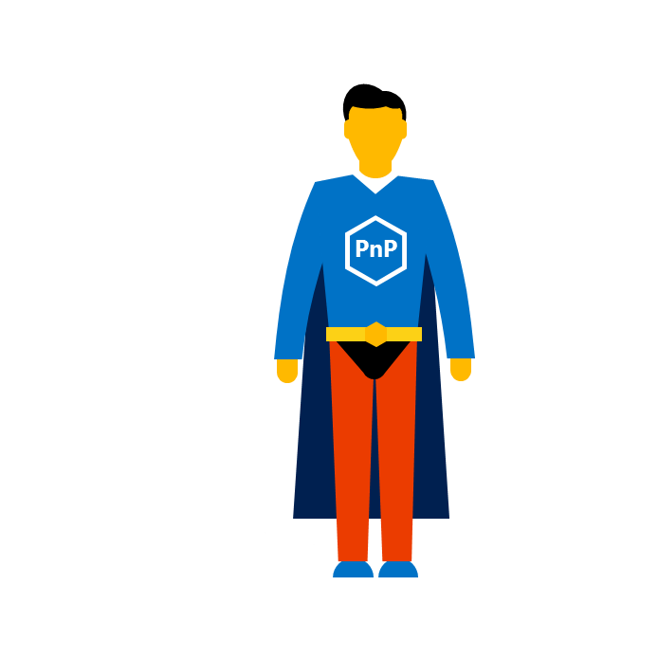

Agenda
Git clone
Hvad indeholder løsningen?
Disclaimer
PnP Provisioning Engine
Site designs and site scripts
Office UI Fabric - DEMO
Hands-on labs
Provisioning af løsningen
PersonalEmail WebPart
Site designs and site scripts
Notes:
Grundet vores MS mand er blevet fordringer, afsætter vi ekstra tid til på Hands-on labs

Slide 3
Git clone

Slide 4
Hvad indeholder løsningen?

Slide 5
Disclaimer

Slide 6
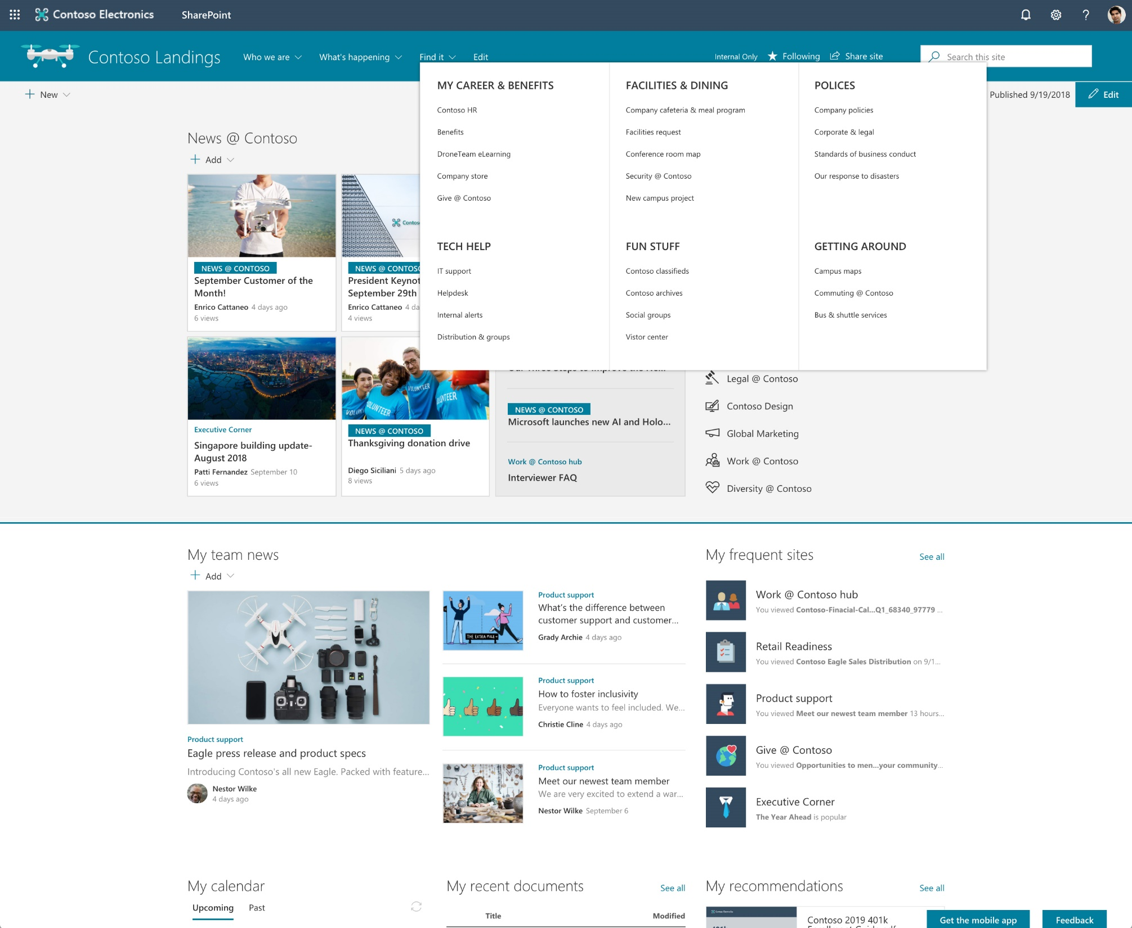
New megamenu
Megamenu navigation styling provides:
More navigation density
Grouping for better organization and hierarchy

Slide 7


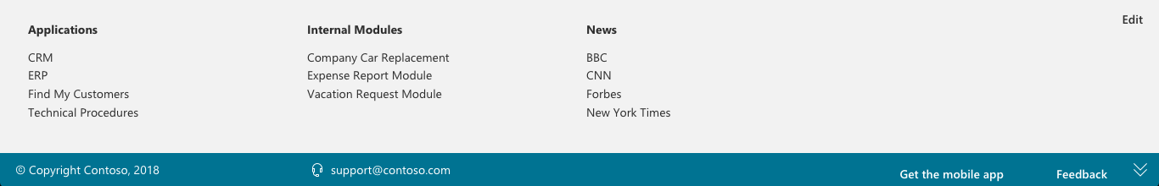
Family of footer options
Simple
Extended
Stacked
SPFx solution using PnP
footer extended (personal links)

Slide 8
PnP Provisioning Engine

Slide 9
Why are still talking about PnP Provisioning Engine?

Slide 10
What is the PnP Provisioning Engine?
Open source community effort
Framework for easily doing Remote Provisioning
Part of the OfficeDev PnP Core Library
Object Oriented engine for easy and fast Remote Provisioning
Capabilities
Automated Remote Provisioning
Easy Site Template Generation/Extraction
Available in Microsoft .NET
There are PowerShell extensions for common tasks
Supports templating of sites and artifacts
Reusable, updatable (delta handling)

Slide 11
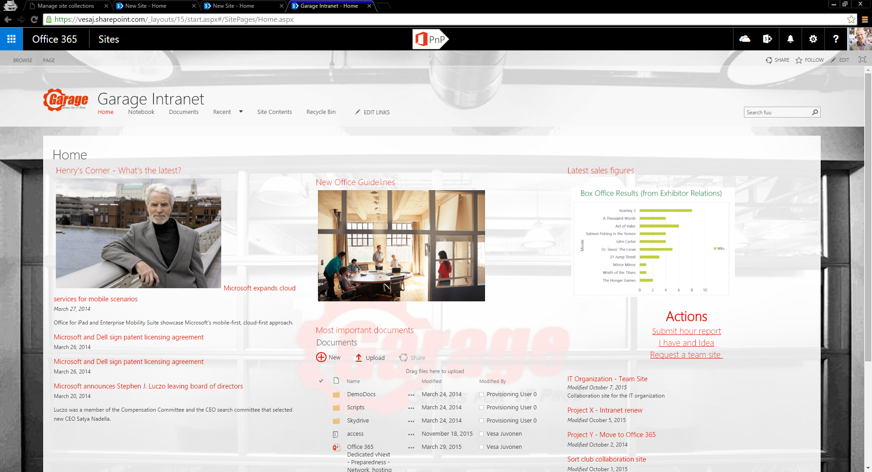
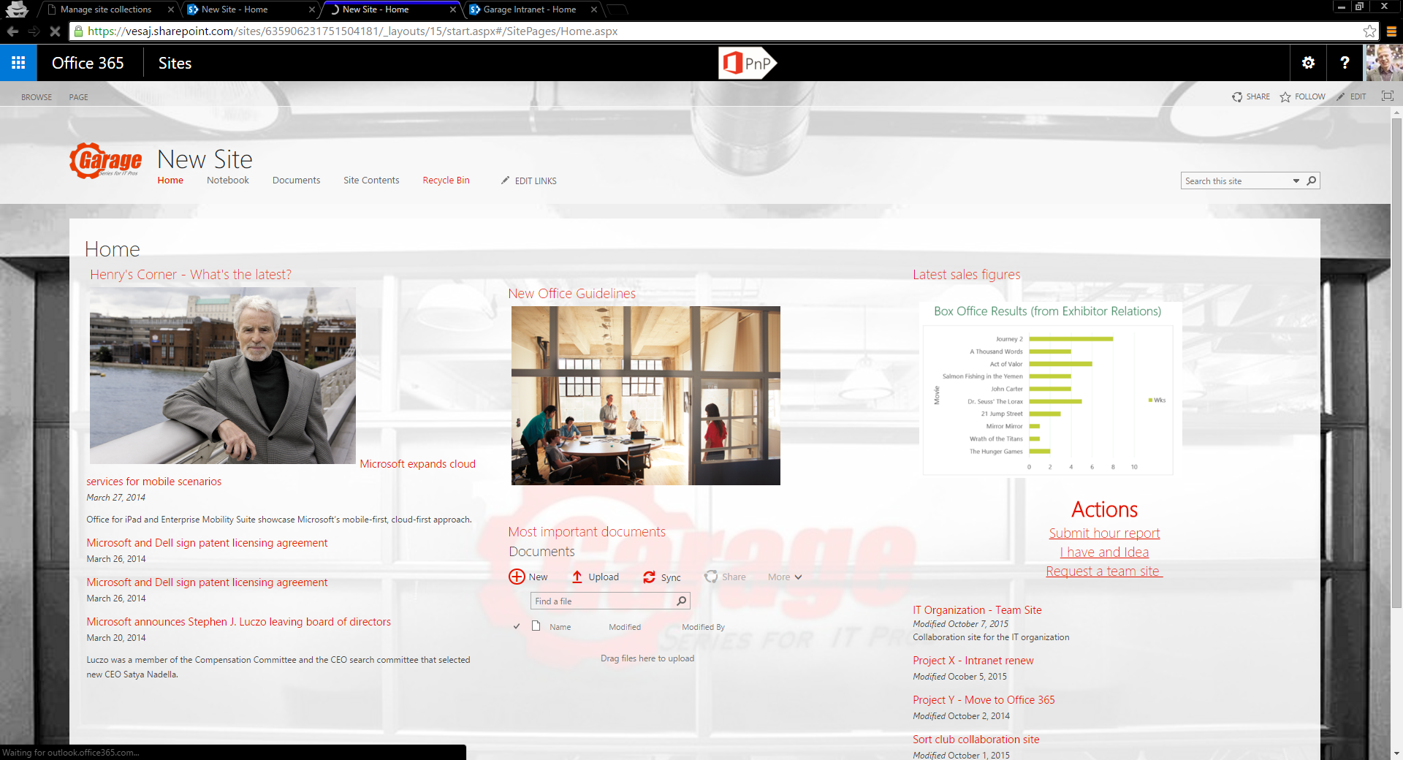
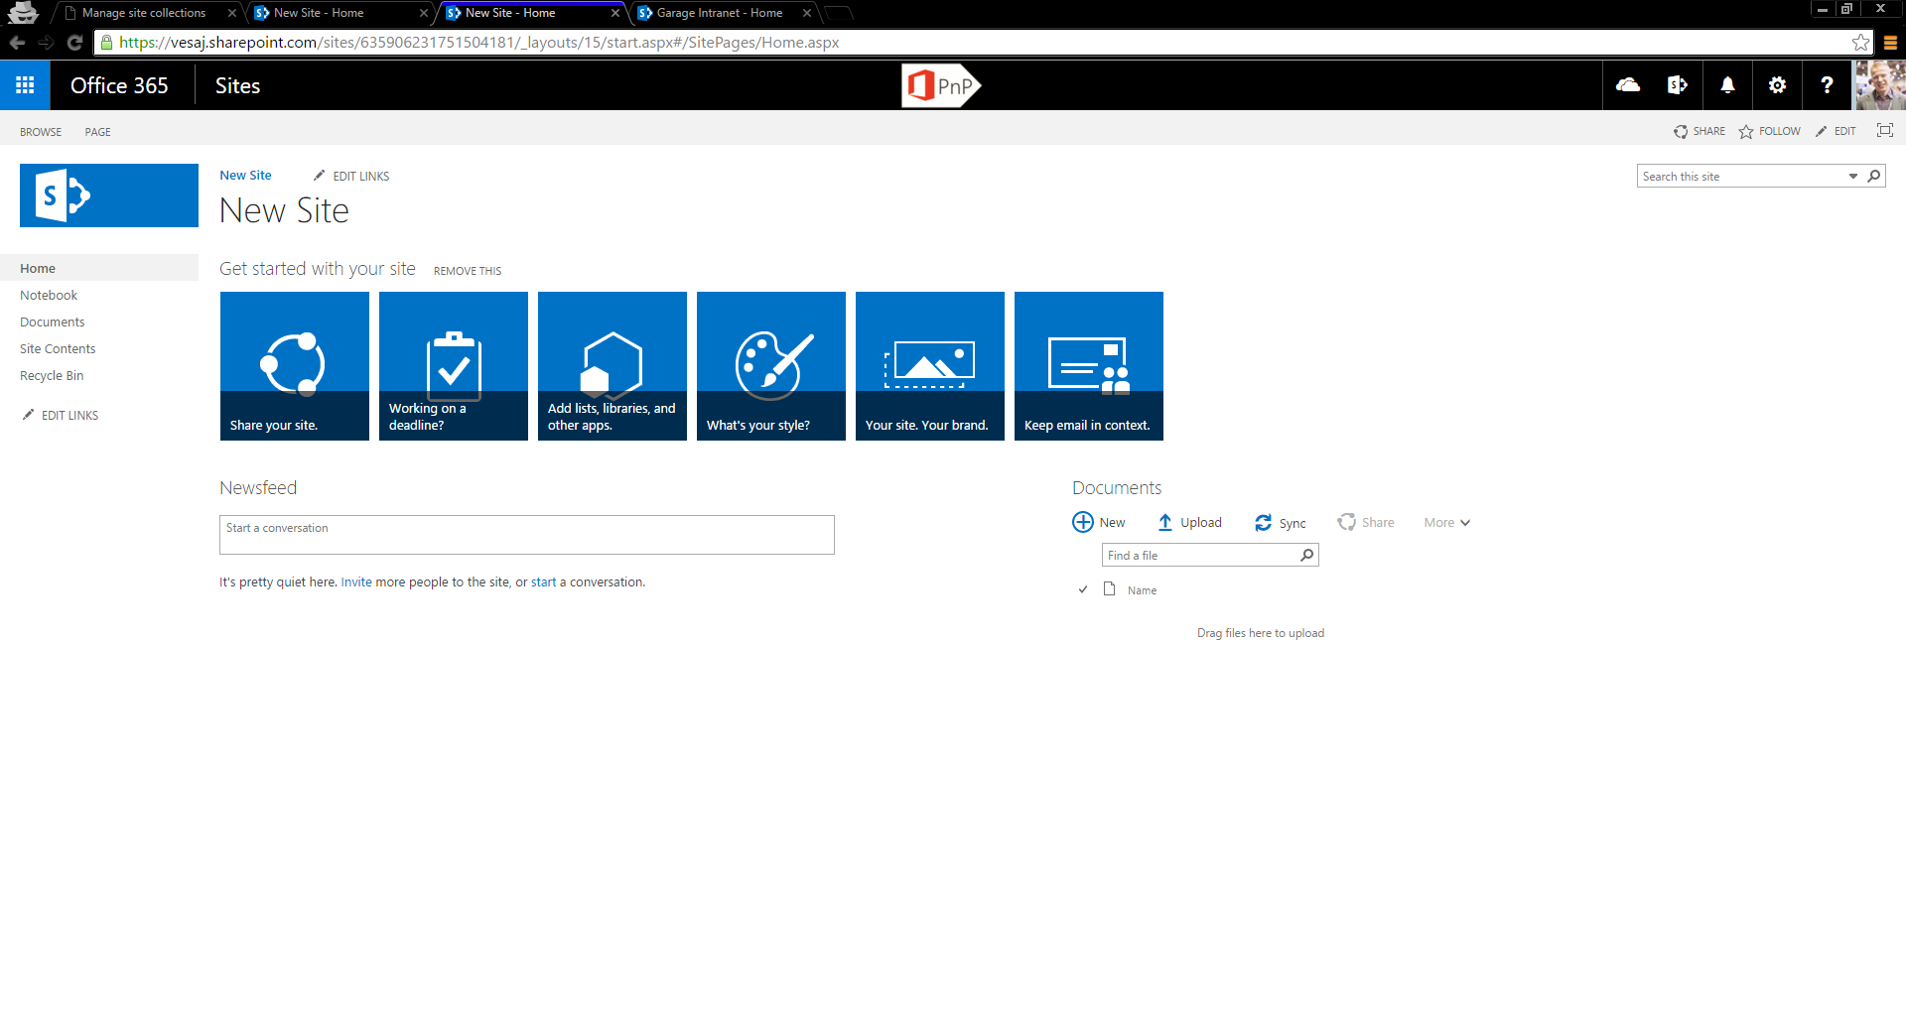
PnP Provisioning Engine – Export/Import
Template site
OOB site with needed configuration
Empty OOB site

Slide 12
PnP-Provisioning-Schema
Schema Review

Slide 13
Site designs and site scripts

Slide 14
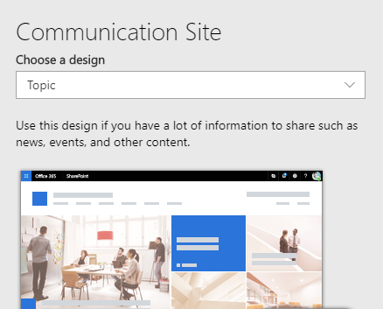
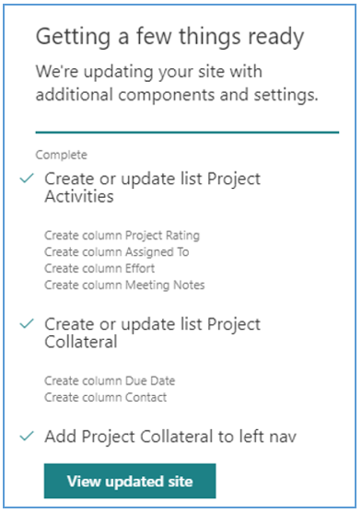
Site designs and site scripts
Site designs
Site scripts

Slide 15
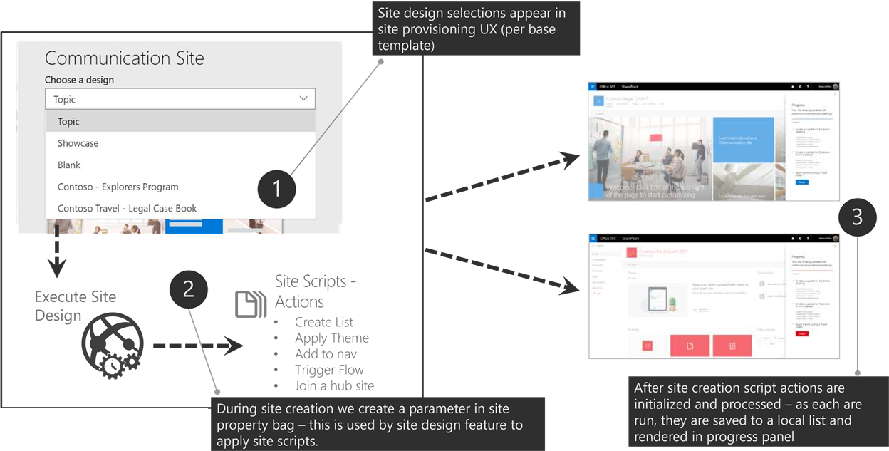
Site designs

Slide 16
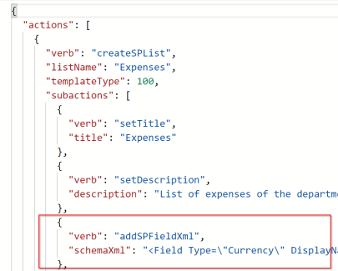
Site scripts JSON

Slide 17
Site scripts actions
Available actions include:
Creating a new list or library (or modifying the default one created with the site)
Creating site columns, content types, and configuring other list settings
Join a hub site
Applying a theme
Setting a site logo
Adding navigation
Triggering a Microsoft Flow
Installing a deployed solution from the app catalog
Setting regional settings for the site
Setting external sharing capability for the site

Slide 18
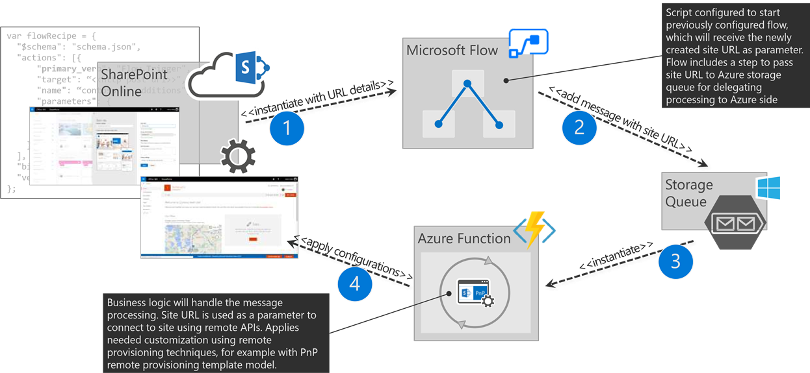
Extending native site creation flow How to integrate custom logic to out of the box provisioning flow?

Slide 19
DEMO

Slide 20
Office UI Fabric - DEMO

Slide 21
Spørgsmål?

Slide 22
Hands-on labs
Provisioning af løsningen
Cheat script: .\Hands-on 3\Files\Apply-StartKitTemplate.ps1
PersonalEmail WebPart
Fejl besked | Muligløsning
Apply-PnPProvisioningHierarchy : {"odata.error":{"code":"-1, Microsoft.SharePoint.Client.ResourceNotFoundException","message":{"lang":"en-US","value":"Cannot find resource for the request SP.RequestContext.current/web/tenantappcatalog/."}}} | Sikker at appcatelog er oprettet eller vent og prøv igen
Apply-PnPProvisioningHierarchy : Access denied. You do not have permission to perform this action or access this resource. | Måske Term Store administrator

